Slide 1
Hadoop: Setting up a Single Node Cluster in Windows

Slide 2
Hadoop: Setting up a Single Node Cluster in Windows
There are two ways to install Hadoop, i.e. Single node and Multi-node.
A single node cluster means only one DataNode running and setting up all the NameNode, DataNode, ResourceManager, and NodeManager on a single machine. This is used for studying and testing purposes.
Install and configure the pseudo-distributed mode of Hadoop 3.1 in Windows 10 by setting up a single node cluster.

Slide 3
Prerequisite:
Java should be installed in the system before installing Hadoop.
Install java version 1.8 in your system. If it is already installed, skip this part and move further.
If java is not installed in your system, then go to
https://www.oracle.com/java/technologies/downloads/#java8
Accept the license and download the file according to your operating system.
Instead of saving as C:\Program Files\Java\jdk1.8.0_261 save the java folder directly under the local disk directory as C:\Java\jdk1.8.0_261 to avoid further errors.

Slide 4
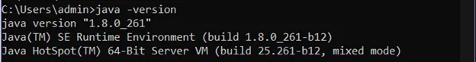
After downloading java check your java version through this command on command prompt (cmd ).

Slide 5
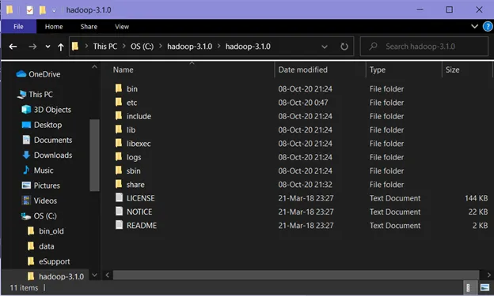
Download Hadoop
Download hadoop version 3.1 from this link.
https://archive.apache.org/dist/hadoop/common/hadoop-3.1.0/hadoop-3.1.0.tar.gz
Both the java folder and hadoop folder should be placed in a single drive. (Here, C:\ drive). This is done to avoid further errors.
Extract it to a folder.

Slide 6
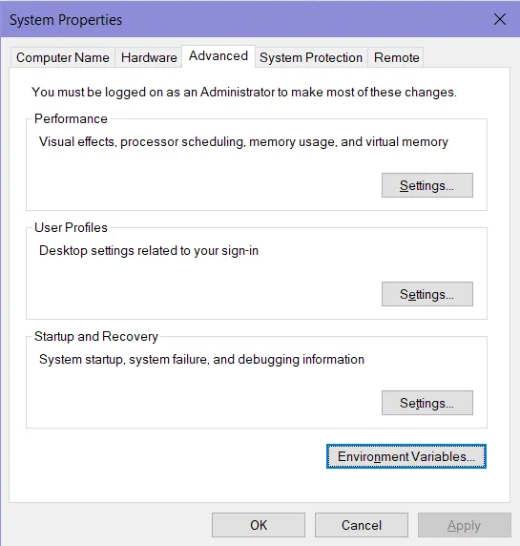
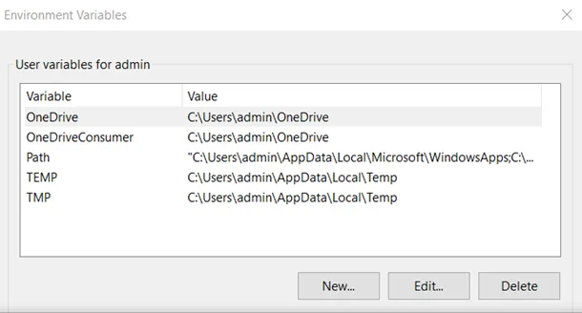
Setup System Environment Variables
To edit the system environment variable, open the control panel and then go to environment variable in system properties.

Slide 7
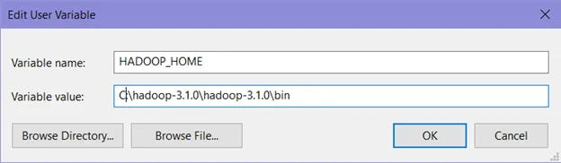
We need to create two new user variables:
Variable name : HADOOP_HOME
Variable value : The path of the bin folder where you extracted hadoop

Slide 8
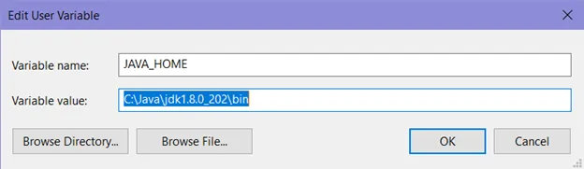
Variable name : JAVA_HOME
Variable value : the path of the bin folder in the Java directory.

Slide 9
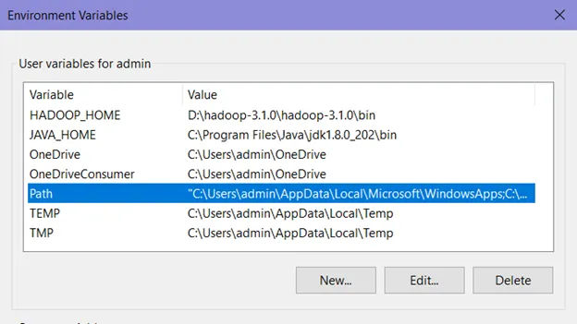
To set Hadoop bin directory and Java bin directory path in system variable path, edit Path in the system variable

Slide 10
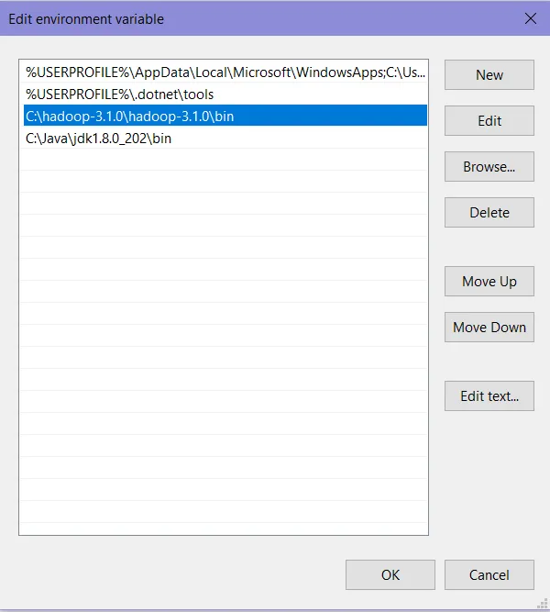
Click on New and add the bin directory path of Hadoop and Java in it.
Both the bin directories should be placed in a single drive. (Here, C:\ drive). This is done to avoid further errors.

Slide 11
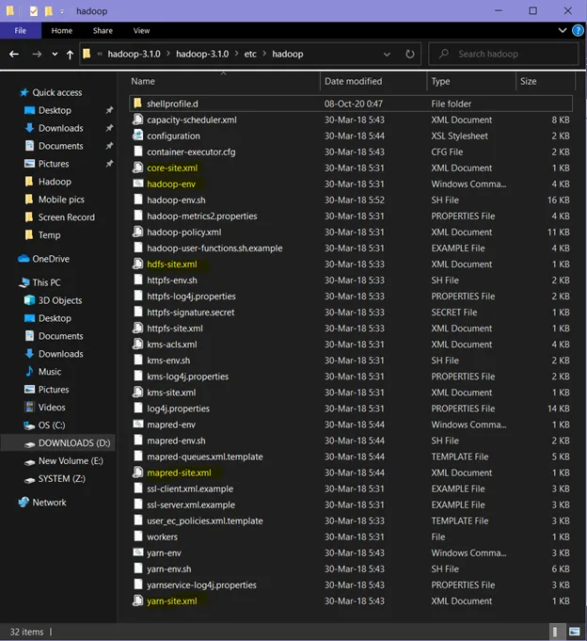
Configurations
Now we need to edit some files located in the hadoop directory of the etc folder where we installed hadoop. ( Here, C:\hadoop-3.1.0\hadoop-3.1.0\etc\hadoop\). The files which are to be edited have been highlighted (in yellow colour).

Slide 12
Edit the core-site.xml file in the hadoop directory. Copy this xml property in the configuration in the file and save it.
<configuration>
<property>
<name>fs.defaultFS</name>
<value>hdfs://localhost:9000</value>
</property>
</configuration>

Slide 13
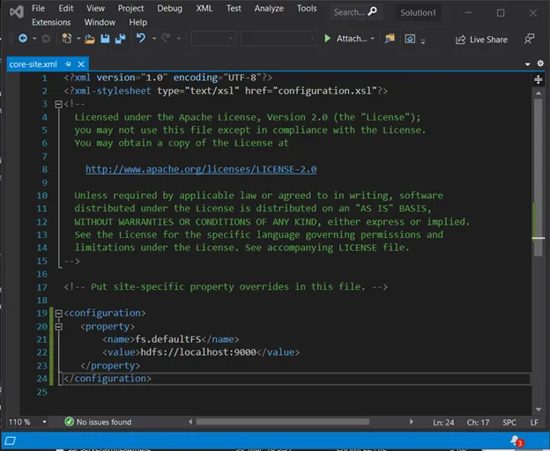

Slide 14
Edit mapred-site.xml and copy this property in the configuration and save it.
<configuration>
<property>
<name>mapreduce.framework.name</name>
<value>yarn</value>
</property>
</configuration>

Slide 15
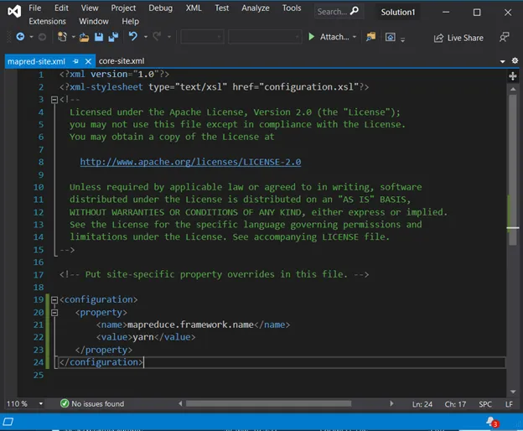

Slide 16
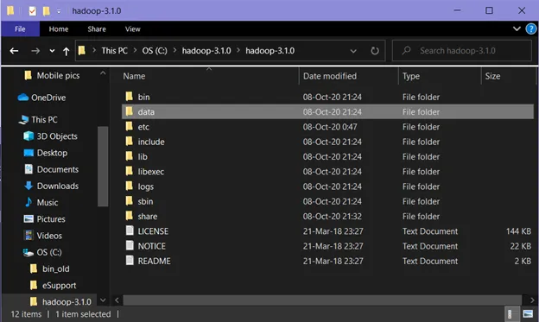
Create a folder data in the hadoop directory
HDFS has a master-slave architecture where the master node is called NameNode and slave node is called DataNode. The NameNode and its DataNodes form a cluster. NameNode acts like an instructor to DataNode while the DataNodes store the actual data.

Slide 17
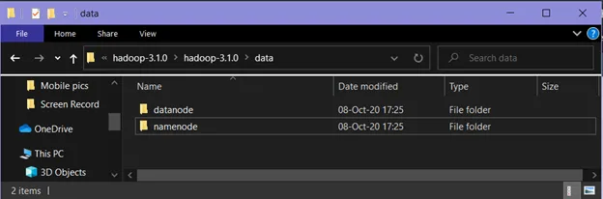
Master-slave architectures are used to help stabilize a system. Master is the true data keeper while a slave is a replication of master. Replication is the process of synchronizing data from the master to slave.
Create two new empty folders with the names datanode and namenode in this newly createddata directory. (Here, C:\hadoop-3.1.0\hadoop-3.1.0\data\namenode and C:\hadoop-3.1.0\hadoop-3.1.0\data\datanode are the paths of namenode and datanode folders respectively.).

Slide 18
Edit the file hdfs-site.xml and add below property in the configuration and save it.
<configuration>
<property>
<name>dfs.replication</name>
<value>1</value>
</property>
<property>
<name>dfs.namenode.name.dir</name>
<value>C:\hadoop-3.1.0\hadoop-3.1.0\data\namenode</value>
</property>
<property>
<name>dfs.datanode.data.dir</name>
<value> C:\hadoop-3.1.0\hadoop-3.1.0\data\datanode</value>
</property>
</configuration>
(Here, C:\hadoop-3.1.0\hadoop-3.1.0\data\namenode and C:\hadoop-3.1.0\hadoop-3.1.0\data\datanode respectively).

Slide 19
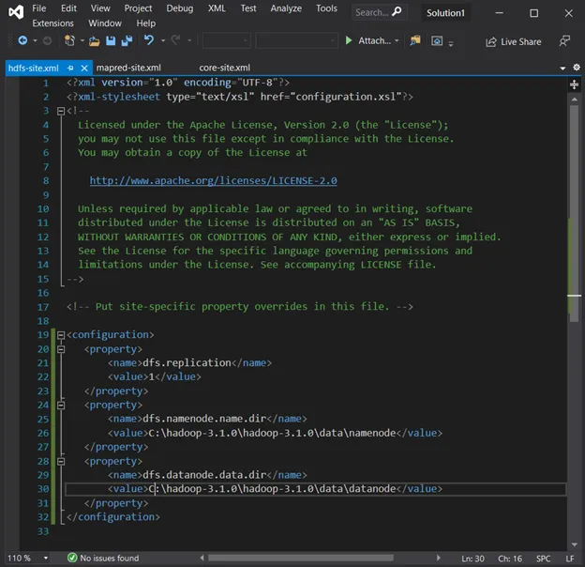

Slide 20
Edit the file yarn-site.xml and add below property in the configuration and save it.
<configuration>
<property>
<name>yarn.nodemanager.aux-services</name>
<value>mapreduce_shuffle</value>
</property>
<property> <name>yarn.nodemanager.auxservices.mapreduce.shuffle.class</name><value>org.apache.hadoop.mapred.ShuffleHandler</value>
</property>
</configuration>

Slide 21
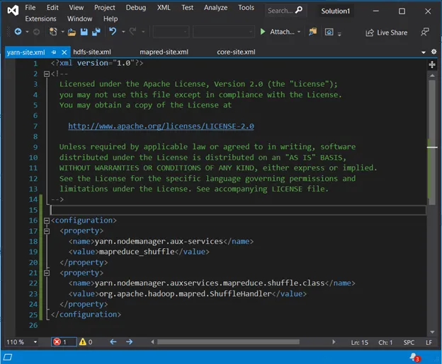

Slide 22
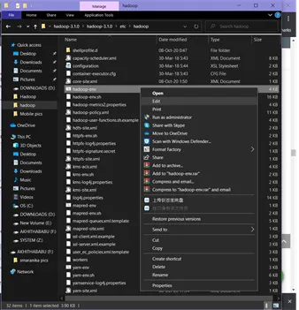
Edit hadoop-env.cmd

Slide 23
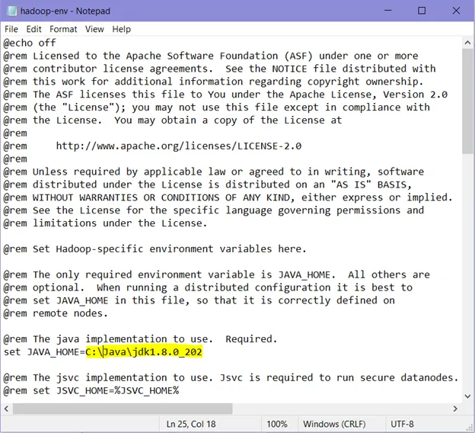
Replace %JAVA_HOME% with the path of the java folder where the jdk 1.8 is installed. (Here, C:\Java\jdk1.8.0_202 which is highlighted in yellow). Then save it.

Slide 24
Hadoop needs Windows OS-specific files which do not come with default download of Hadoop.
To include those files, replace the bin folder in hadoop directory with the bin folder provided in this GitHub link.
https://github.com/s911415/apache-hadoop-3.1.0-winutils
Download it as zip file. Extract it and copy the bin folder in it. If you want to save the old bin folder, rename it like bin_old .

Slide 25
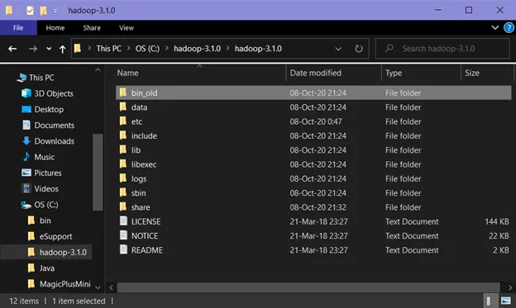

Slide 26
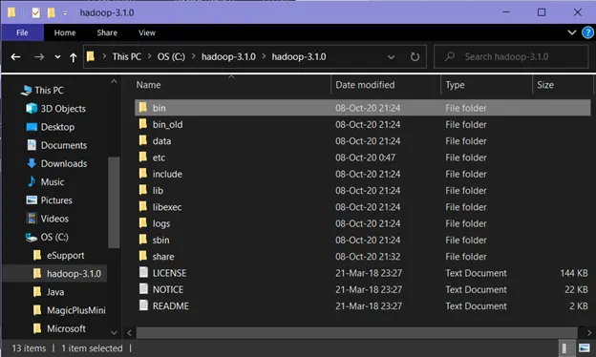
Now paste the copied bin folder in that directory

Slide 27
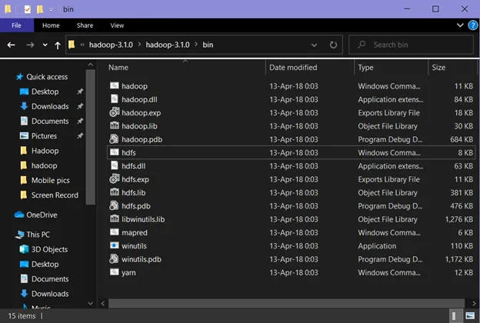
The new bin folder has 15 files in it.

Slide 28
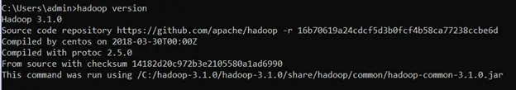
Check whether hadoop is successfully installed by running this command on cmd-
hadoop version
Since it doesn’t throw any error and successfully shows the hadoop version,

Slide 29
Format the NameNode
Once the hadoop is installed, the NameNode is formatted. This is done to avoid deletion of all the data inside HDFS. Run this command-
hdfs namenode –format

Slide 30
One last thing
Copy hadoop-yarn-server-timelineservice-3.1.0 from timelineservice folder in yarn directory which is in hadoop located in the hadoop directory of the share folder where we installed hadoop to yarn directory which is in hadoop located in the hadoop directory of the share folder where we installed hadoop.
ie., \hadoop-3.1.0\share\hadoop\yarn\timelineservice to \hadoop-3.1.0\share\hadoop\yarn folder.
(Here, C:\hadoop-3.1.0\hadoop-3.1.0\share\hadoop\yarn\timelineservice to C:\hadoop-3.1.0\hadoop-3.1.0\share\hadoop\yarn folder.)

Slide 31
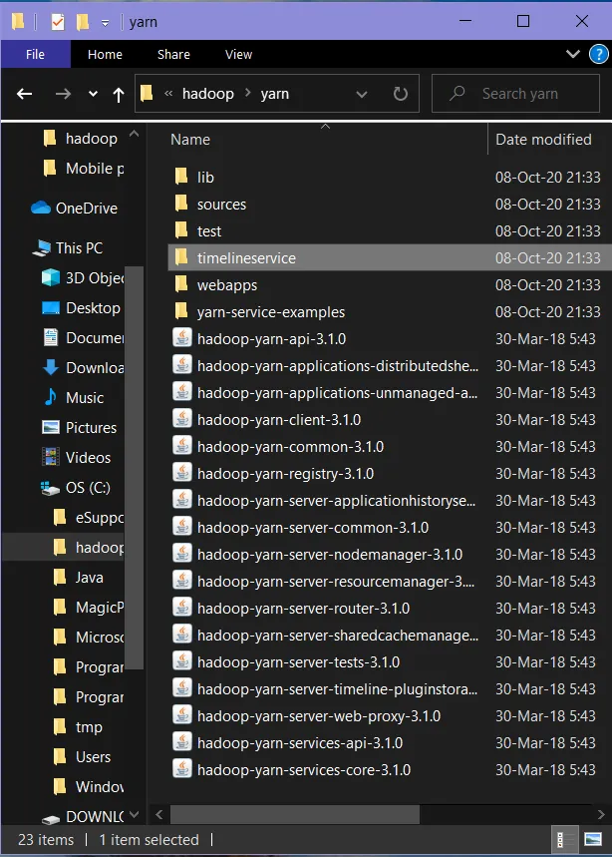

Slide 32
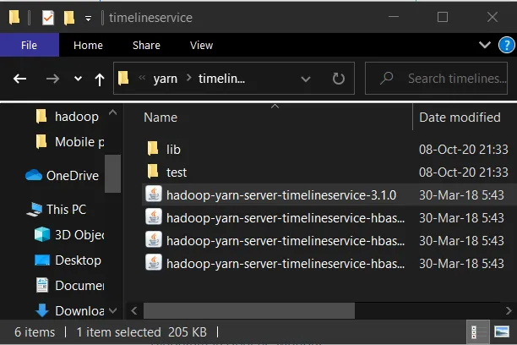
Copy hadoop-yarn-server-timelineservice-3.1.0

Slide 33
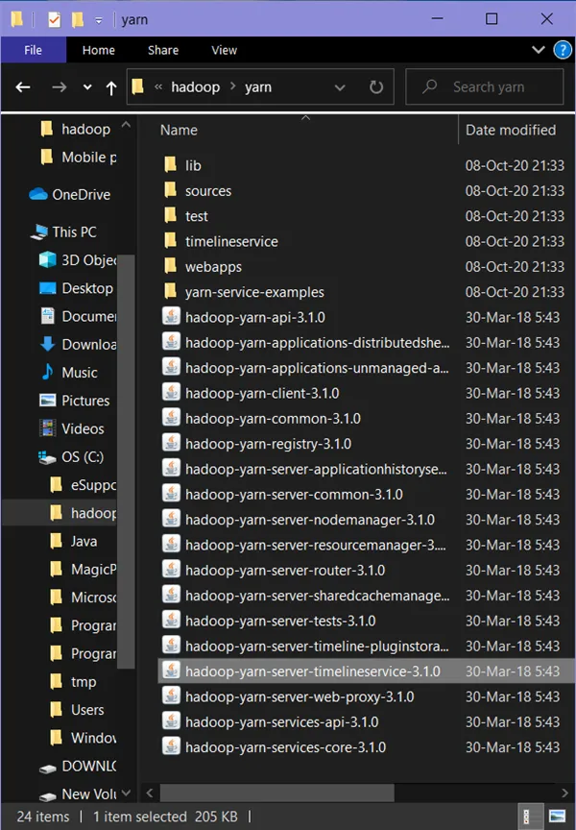
Paste hadoop-yarn-server-timelineservice-3.1.0 in yarn folder

Slide 34
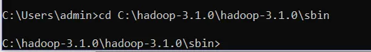
To start run all the Apache Hadoop Distribution
Now change the directory in cmd to sbin folder of hadoop directory with this command,
Make sure you are writing the path as per your system. (Here, C:\hadoop-3.1.0\hadoop-3.1.0\sbin )
cd C:\hadoop-3.1.0\hadoop-3.1.0\sbin

Slide 35
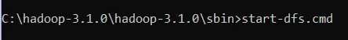
Start namenode and datanode with this command –
start-dfs.cmd

Slide 36
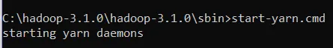
Two more cmd windows will open for NameNode and DataNode
Now start yarn through this command-
start-yarn.cmd
Two more windows will open, one for yarn resource manager and one for yarn node manager. Make sure all the 4 Apache Hadoop Distribution windows (hadoop namenode, hadoop datanode, yarn nodemanager, yarn resourcemanager) pops up and are running. If they are not running, you will see an error or a shutdown message. In such a case, you need to debug the error.

Slide 37
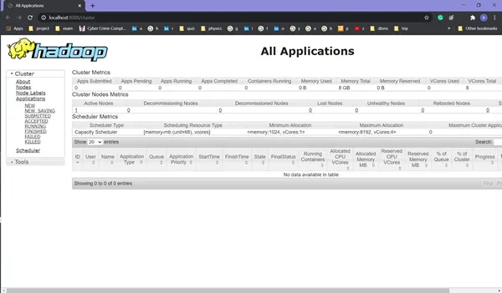
Verification
To access information about resource manager current jobs, successful and failed jobs, go to this link in browser- http://localhost:8088/cluster

Slide 38
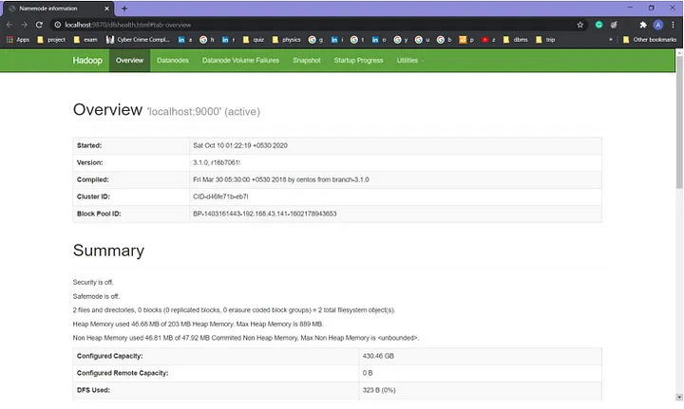
To check the details about the hdfs (namenode and datanode), go to this link in browser- http://localhost:50070/I
f you are using Hadoop version prior to 3.0.0 — Alpha 1, then use port http://localhost:50070/

Slide 39
The term Hadoop is often used for both base modules and sub-modules and also the ecosystem, or collection of additional software packages that can be installed on top of or alongside Hadoop, such as Apache Pig, Apache Hive, Apache HBase, Apache Phoenix, Apache Spark, Apache ZooKeeper, Cloudera Impala, Apache Flume, Apache Sqoop, Apache Oozie, and Apache Storm. You can download this software as well in your windows system to perform data processing operations using cmd.

